Slide 1
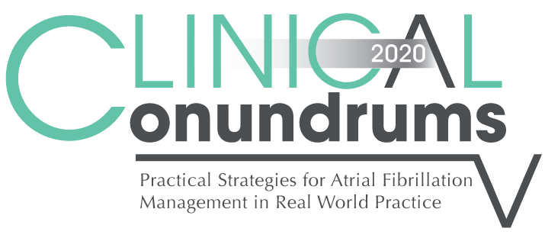


Case 6
CASE 5
Beth
Stroke Prevention in the Elderly Patient with Atrial Fibrillation

Slide 2

Learning Objectives
Upon completion of this activity, participants should be able to:
I
Recognize that the risks of AF, stroke, major bleeding are all increased in the elderly
II
Describe that DOACs are as effective in older patients as they are in younger patients with AF, with a risk of major bleeding that is similar to or less than that of warfarin
III
Explain the importance of follow up and close monitoring of renal function in elderly patients on DOACs
IV
Integrate the individual values and preferences of elderly AF patients into shared decision making on anticoagulation

Slide 3

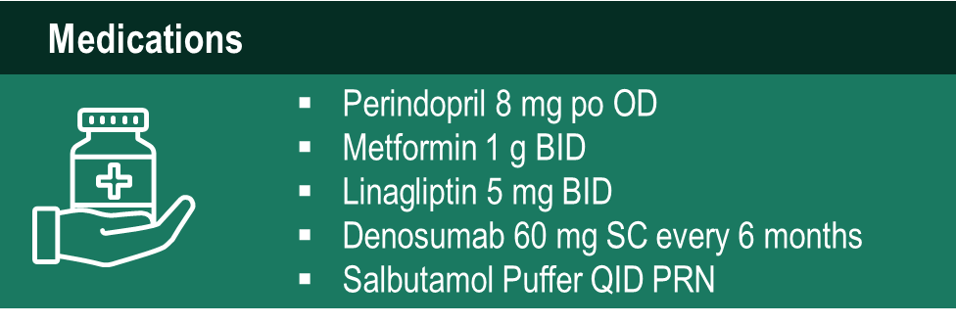
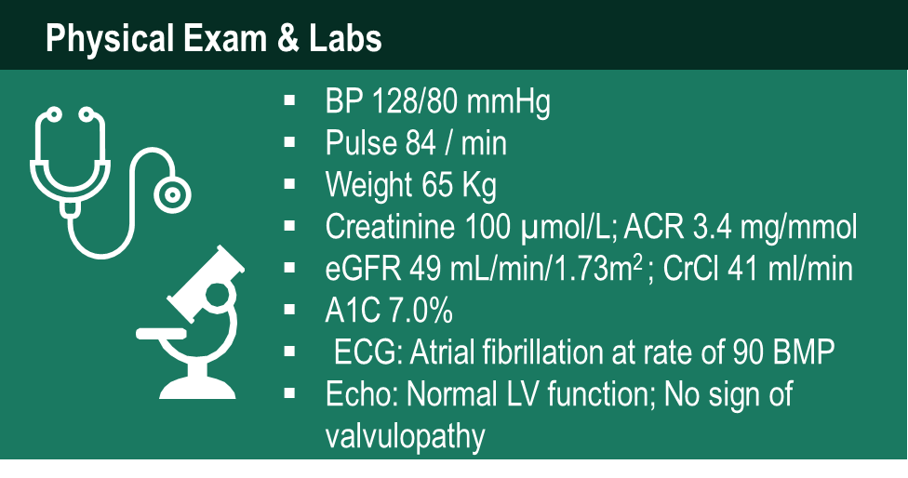
Case 6
Beth
79 years old
Notes:
Speaker Notes:

Slide 4
Case 6
Beth
79 years old
Beth comes in for a routine diabetes follow up visit.
She feels ok, but occasionally feels her “heart skip”
Notes:
Speaker Notes:

Slide 5
Case 6
Beth
79 years old
Beth has never heard of AF, and is unaware of the risks of stroke with AF or the potential consequences of an AF related stroke
She is very concerned about bleeding risks with “blood thinners”
She is not fazed by the prospect of death, avoiding death has low value for her, but she very much wants to avoid becoming more disabled and dependent.
Notes:
Speaker Notes:

Slide 6

Things to discuss with Beth
1
AF-related strokes are very common

Slide 7
Incidence of AF is Expected to Increase: A function of population aging and increased incidence of risk factors for AF
Age-and Sex-Adjusted Incidence of AF in 1995-2000
Projected Number of Persons With AF in the United States Between 2000 and 2050
16
14
12
10
8
6
4
2
0
15.2
15.9
13.1
15.9
10.2
11.7
8.9
11.7
12.1
Projected Number of Persons with AF (Millions)
7.7
10.3
11.1
5.9
6.7
8.4
9.4
5.1
7.5
6.1
6.8
5.1
5.6
Year
2000 2005 2010 2015 2020 2025 2030 2035 2040 2045 2050
Assumes no further increase in age-adjusted AF incidence (blue) and assumes a continued increase in incidence rate as evident in 1980 to 2000 (orange curve)
Miyasaka Y et al. Circulation. 2006; 114: 119-125
Notes:
Speaker Notes:
Atrial fibrillation is more common in men than in women at all ages and increases significantly with age. Demographic projections suggest a tripling of the frequency over the next 40 years.
The age- and sex-adjusted incidence of AF in 1995 to 2000, in Olmstead County, Minnesota, US, is shown in the graph on the left. Age was clearly an important risk factor for AF, with virtually no cases among individuals aged <55 years. The incidence per 1000 patient years increased to over 40 and to almost 29 among men and women, respectively, aged ≥85 years.
The graph on the right shows the projected number of persons with AF in the US between 2000 and 2050. Miyasaka and colleagues project that, by year 2050, nearly 15.9 million people will have AF, assuming a continued increase in incidence rate similar to that in 1980-2000. All of these patients are at increased risk for stroke.
Reference
Miyasaka Y, Barnes ME, Gersh BJ et al. Secular trends in incidence of atrial fibrillation in Olmsted County, Minnesota, 1980 to 2000, and implications on the projections for future prevalence. Circulation 2006;114:119-125
.

Slide 8
AF Increases the Risk of Ischemic Stroke by 3 to 5 Times¹
Risk of stroke in AF patients by age group²
Risk of stroke in AF patients
~20% of all strokes are caused by AF²
European Heart Rhythm Associations, et al. Eur Heart J. 2010;31(19):2369-429.
Wolf PA, et al. Stroke. 1991;22(8):983-8
Notes:
Speaker Notes:

Slide 9
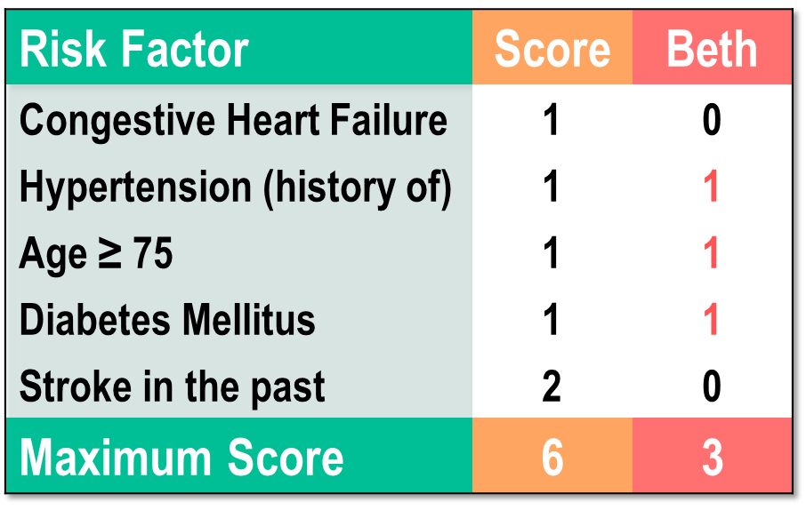
Calculate Beth’s Stroke Risk
Beth’s Stroke Risk = 5.9% / yr
1733 patients from National Registry of Atrial Fibrillation (NRAF)
Stroke rate/ 100 patient-years
Gage BF et al. JAMA 2001;285:2864-70
Notes:
Speaker Notes:

Slide 10
Updated Definitions of CHADS₂ Components
CHF = S/S of systolic CHF ( ⬇ LVEF assumed), mod-severe ⬇ LVEF, hospitalization with CHF regardless of LVEF
Age = ≥ 65 years
HTN = resting BP >140 systolic or >90 diastolic on two occasions or current antihypertensive drug treatment
Diabetes mellitus = fasting glucose ≥ 7.0 mmol/L (126 mg/dL) or treatment with oral hypoglycemic agents or insulin
Stroke = ischemic stroke or TIA diagnosed by a neurologist or systemic or pulmonary thromboembolism
Vascular disease = CAD, PVD, or aortic plaque
Macle L et al. Can J Cardiol 31:1207-18, 2015
Notes:
Speaker Notes:

Slide 11
Things to discuss with Beth
1
AF-related strokes are very common
2
AF-related strokes are often devastating

Slide 12
Stroke Severity in Patients with AF
Effect of first ischemic stroke in patients with AF (n=597)¹
% of patients
Gladstone DJ et al. Stroke. 2009; 40:235-240
Notes:
Speaker Notes:
In a recent study by Gladstone and colleagues of nearly 600 patients who were admitted to the hospital with a first ischemic stroke from AF, 60% were disabling and 20% were fatal.

Slide 13
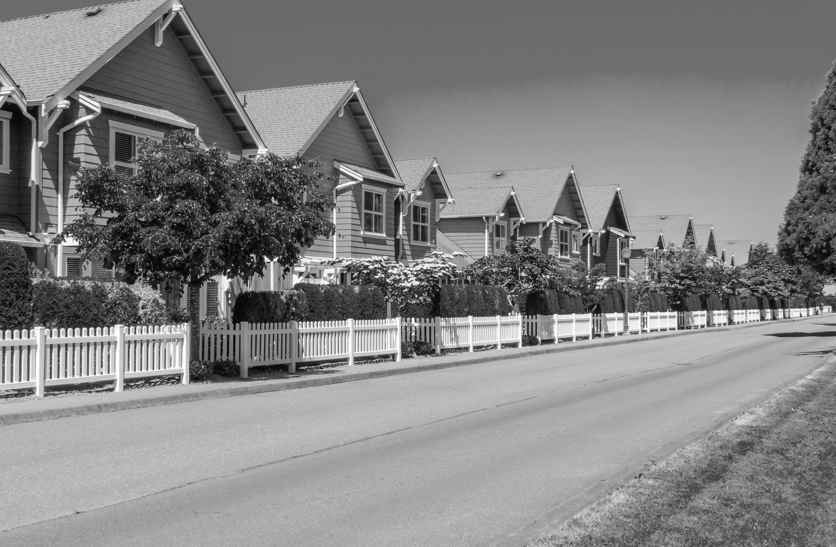


AF-Related Strokes Are More Severe
Among patients who had a stroke, those with AF experienced a:
20%
increase in the length of hospital stay‡
40%
decrease in the relative chance of discharge to own home†
60%
…compared to those without AF
increase in in-hospital mortality**
Jorgensen, et al. Stroke 1996;27:1765-9 *The Copenhagen stroke study, a prospective community-based study. n=1,197
**In hospital mortality: 72 deaths, n=217 with AF vs. 171 deaths n=968 without AF
†Discharge to own home: n=104 with AF vs. 662 deaths n=968 without AF
‡Length of hospital stay: 50.4 days with AF vs. 39.8 days without AF
Notes:
Speaker Notes:

Slide 14
Things to discuss with Beth
1
AF-related strokes are very common
2
AF-related strokes are often devastating
3
AF-related strokes can be prevented

Slide 15
AF-Related Strokes Can Be Prevented
5-year Stroke/SE risk in NVAF Patients (annual risk 5%)
Notes:
Speaker Notes:
Assuming a 5% annual risk of stroke in the absence of preventative treatment for a hypothetical AF population. That population and its annual 5% risk of stroke are cycled through 5 years to determine the five year risk of stroke on various treatments
Speaker should emphasize limitation of indirect comparisons as the DOACs were tested against warfarin in different populations in RCTs and not tested against each other prospectively.
Key point is the major benefit of warfarin or any DOAC vs. ASA which should no longer be used for this indication

Slide 16
Things to discuss with Beth
1
AF-related strokes are very common
2
AF-related strokes are often devastating
3
AF-related strokes can be prevented
4
…even in the elderly

Slide 17
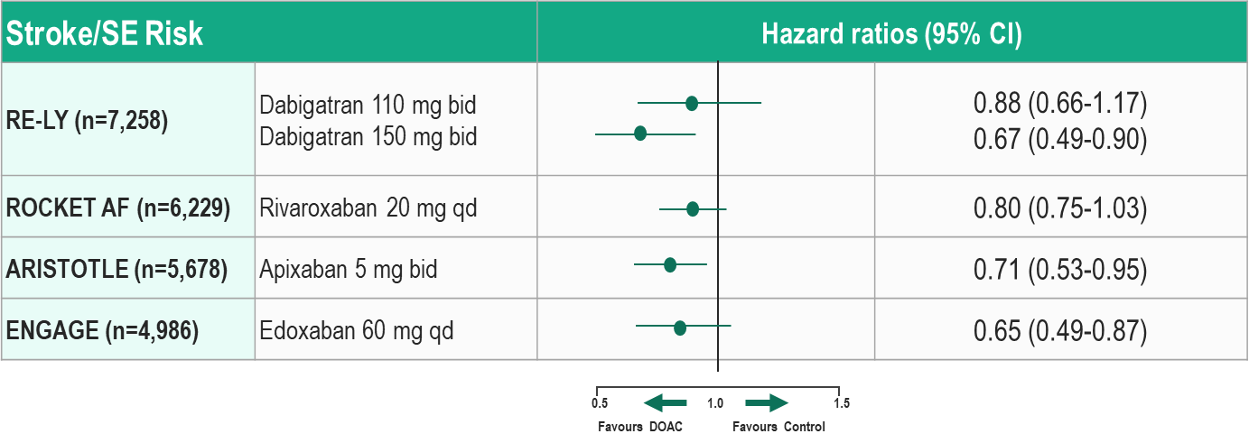
DOACs in Patients Aged ≥ 75 years: Stroke/SE Risk
1. Connolly SJ, et al. N Engl J Med 2009; 361:1139-51.; 2. Patel MR, et al. N Engl J Med 2011; 365:883-91.
3. Granger CB, et al. N Engl J Med. 2011;365:981-92.; 4. Kato ET, et al. J Am Heart Assoc. 2016;5(5).
Notes:
Speaker Notes:
Each of the pivotal trials of DOAC therapy versus adjusted-dose warfarin therapy for the prevention of stroke/systemic thromboembolism in patient with nonvalvular atrial fibrillation have report results separately for patients 75 years and older. This slide shows point estimates and 95% CI for the comparison of stroke or systemic thromboembolism on each DOAC in comparison to adjusted warfarin therapy. Each of the point estimates is on the” favors DOAC” side of equality and the point estimates for higher dose dabigatran therapy and for apixaban therapy were statistically superior to that of adjusted dose warfarin for this outcome.

Slide 18
Things to discuss with Beth
1
AF-related strokes are very common
2
AF-related strokes are often devastating
3
AF-related strokes can be prevented
4
…even in the elderly
5
…with a bleeding risk less than warfarin

Slide 19
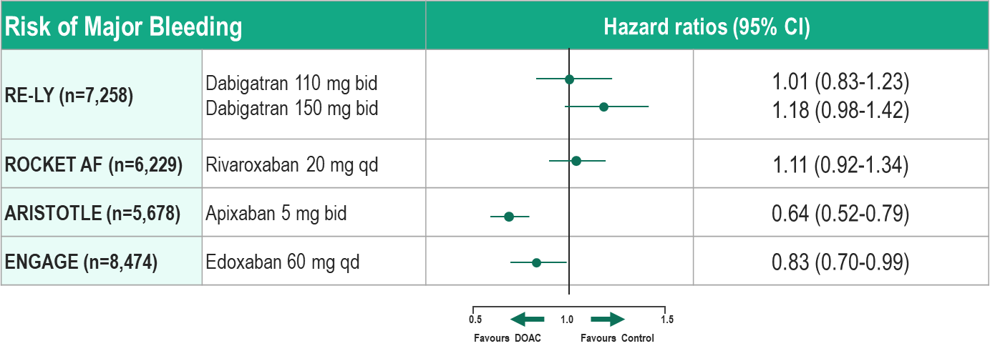
DOACs in Patients Aged ≥ 75 years: Bleeding Risk
1. Connolly SJ, et al. N Engl J Med 2009; 361:1139-51.; 2. Patel MR, et al. N Engl J Med 2011; 365:883-91.
3. Granger CB, et al. N Engl J Med. 2011;365:981-92.; 4. Kato ET, et al. J Am Heart Assoc. 2016;5(5).
Notes:
Speaker Notes:
Each of the pivotal trials of DOAC therapy versus adjusted-dose warfarin therapy for the prevention of stroke/systemic thromboembolism in patient with nonvalvular atrial fibrillation have report results separately for patients 75 years and older. This slide shows point estimates and 95% CI for the comparison of major bleeding on each DOAC in comparison to adjusted warfarin therapy. The point estimates are on the ” favors DOAC” side of equality for apixaban and for edoxaban (both statistically significant). For the other agents the point estimates for major bleed in were on the “favors warfarin” side of equality although not were statistically significant.

Slide 20
Things to discuss with Beth
1
AF-related strokes are very common
2
AF-related strokes are often devastating
3
AF-related strokes can be prevented
4
…even in the elderly
5
…with a bleeding risk less than warfarin
6
…and compared to ASA

Slide 21
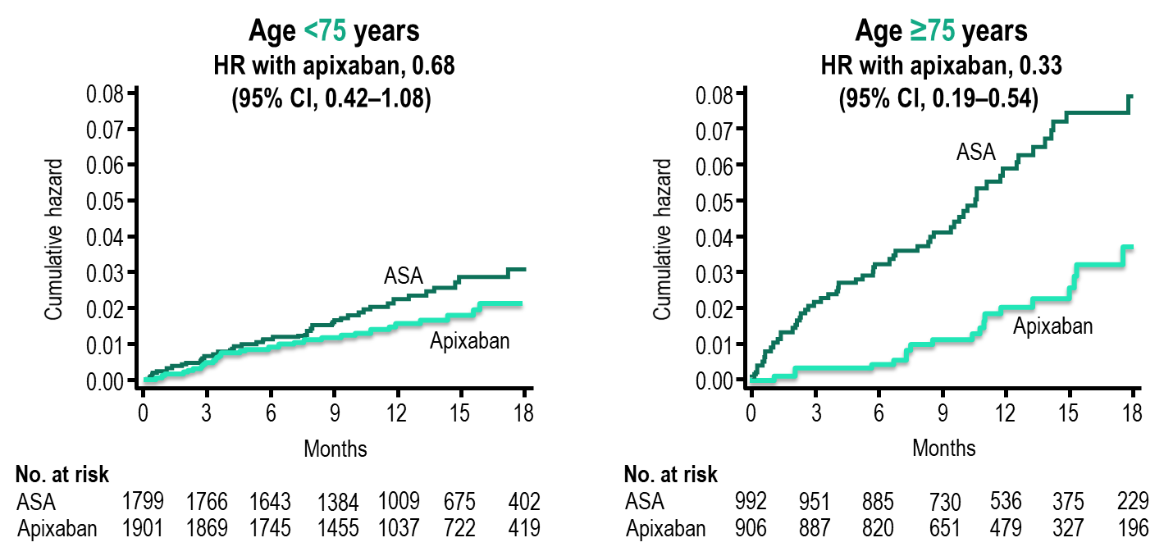
AVERROES: Above and below 75 years of age Stroke Prevention
Cumulative hazard rates of stroke in ASA and apixaban
treatment groups, in patients <75 years or ≥ 75 years old.
P-value for interaction = 0.04
Age and Ageing 2015: 0:1-7 doi: 10.1093/ageing/afv156
Notes:
Speaker Notes:
Increased efficacy of apixaban in the elderly
In this paper we have reported evidence that for stroke prevention,
the efﬁcacy of apixaban in comparison to aspirin
increases with age. In patients =75 years, there was a greater
relative risk reduction with apixaban (HR 0.33, 95% CI
0.18–0.56) compared with younger patients (HR 0.68, 95%
CI 0.42–1.08; P-value for interaction = 0.04) (Figure 1). The
number needed to treat (NNT, calculated as 1/[absolute risk
reduction]) per year to prevent a stroke was 26 in patients
=75 compared with a NNT of 143 in younger patients. In
contrast, the relative efﬁcacy of aspirin to prevent ischaemic
stroke decreases as patients with AF age and appears ineffectual
as patients enter their eighth decade [8]. The beneﬁtof
apixaban with advancing age appears to be due to a rapidly
increasing stroke risk on aspirin, whereas the stroke risk on
apixaban is relatively consistent across age groups (Figure 2A).
In the absence of a comparator group with no antiplatelets or
anticoagulants, it is not possible to determine conclusively
from our data if this is due to a loss of efﬁcacy of aspirin with
age or an increase in efﬁcacy with apixaban. However, as most
elderly patients not anticoagulated will be prescribed aspirin,
the ﬁndings of this analysis are clinically relevant.

Slide 22
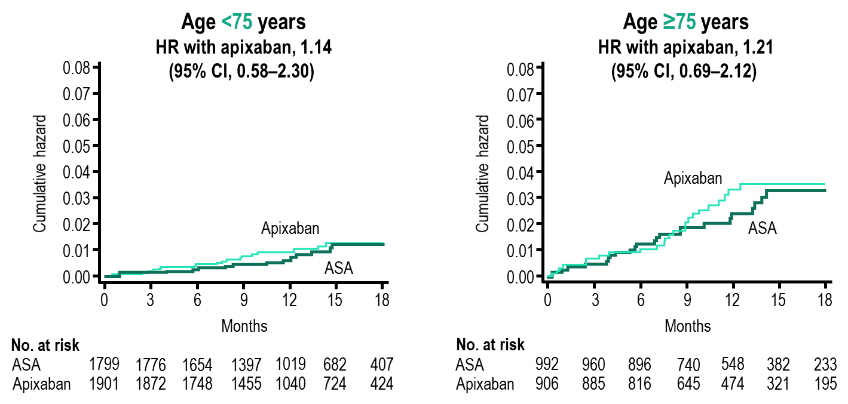
AVERROES: Above and below 75 years of age Bleeding
Cumulative hazard rates of major bleeding in ASA and apixaban
treatment groups, in patients <75 years or ≥ 75 years old.
P-value not available
Age and Ageing 2015: 0:1-7 doi: 10.1093/ageing/afv156
Notes:
Speaker Notes:
Risk of bleeding with initiation of apixaban
Patients enrolled onto AVERROES were not anticoagulated
with vitamin K antagonist therapy either because it was unsuitable
or expected to be unsuitable. Multiple physician and
patient factors were listed for patients not being suitable for
VKA but most patients were unsuitable for multiple reasons
(Supplementary data, Table S4, available in Age and Ageing
online). A large proportion of older patients (42.6%) had
previously failed VKA therapy and of that group, 9.5% had
serious bleeding due to VKA therapy.
In general, apixaban has a similar major bleeding rate to
aspirin in patients who were previously not deemed suitable
for anticoagulation with VKA. The risk of bleeding increased
on both treatments with age (Figure 2B). However even in
the very elderly, apixaban was as safe as aspirin in regards to
bleeding. For intracranial haemorrhage, there is some evidence
that apixaban is safer than aspirin in patients =85
years though absolute event rates were low.

Slide 23

Things to discuss with Beth
1
AF-related strokes are very common
2
AF-related strokes are often devastating
3
AF-related strokes can be prevented
4
…even in the elderly
5
…with a bleeding risk less than warfarin
6
…and compared to ASA

Slide 24
Older CV Patients Would Rather Avoid Stroke/MI Than Death
P<0.001
Age
No information on stroke outcomes/disability provided.
Relative (subjective) weight vs. death for stroke: Age 75-84: 1.48, Age ≥ 85: 3.64
Weight
N=785
Stolker et al. Circulation 2014;130:1254-61
Notes:
Speaker Notes:
A sample of 785 cardiovascular patients and 164 clinical trialists were given 25 tokens to spend on to prevent each of five endpoints – death, MI, stroke, revascularization, or rehospitalization. The spending patterns are then interpreted to represent the relative importance of preventing each outcome compared to the other outcomes expressed as a proportion of 100% for varying age groups.
Elderly patients fear stroke more than death itself!
Therefore, there is no age at which SPAF should not be considered as beneficial to our patients despite the higher risk of bleeding with age.
Rethinking Composite Endpoints in Clinical Trials – Insights From Patients and Trialists
Patients and clinical trialists did not weigh individual components of a composite endpoint equally. Whereas trialists are most concerned about avoiding death, patients place equal or greater importance on reducing MI or stroke.
Both groups considered revascularization and hospitalization as substantially less severe.
These findings suggest that equal weights in a composite clinical endpoint do not accurately reflect the preferences of either patients or trialists

Slide 25
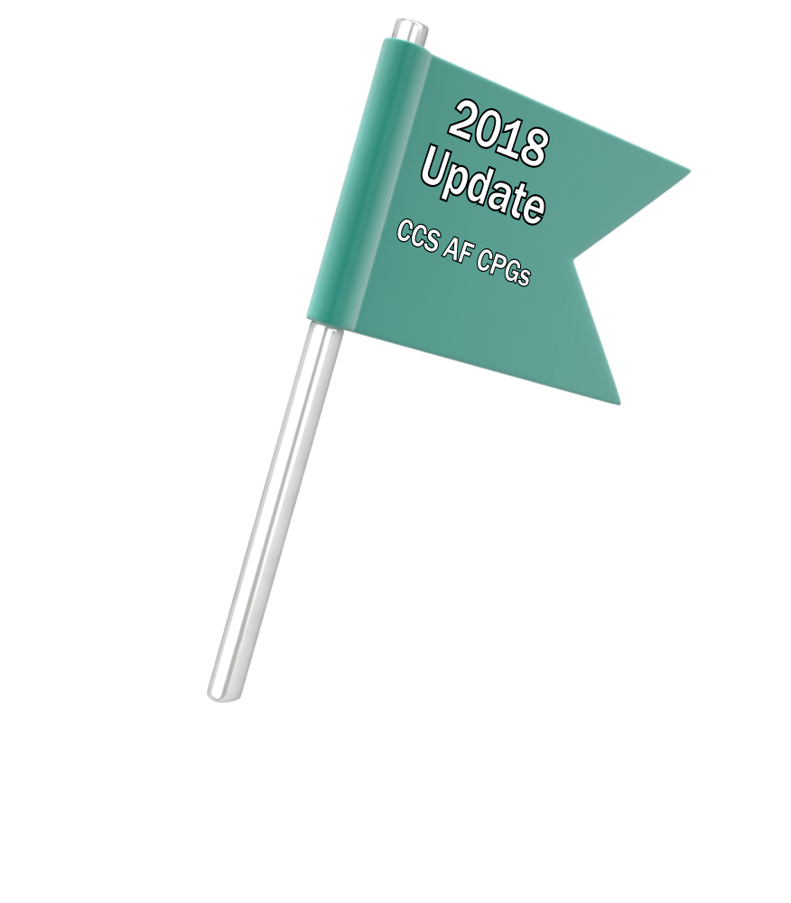
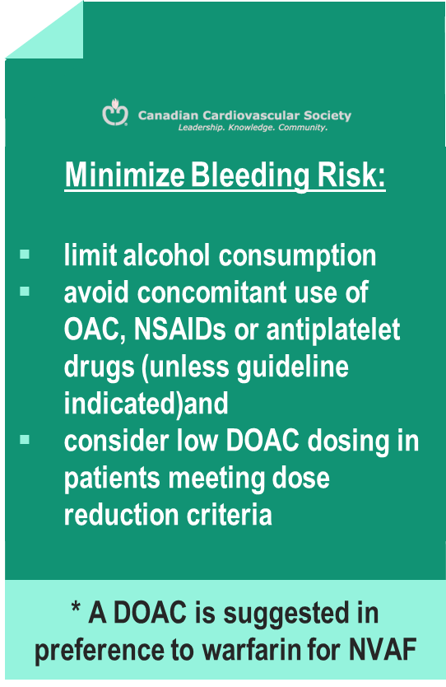
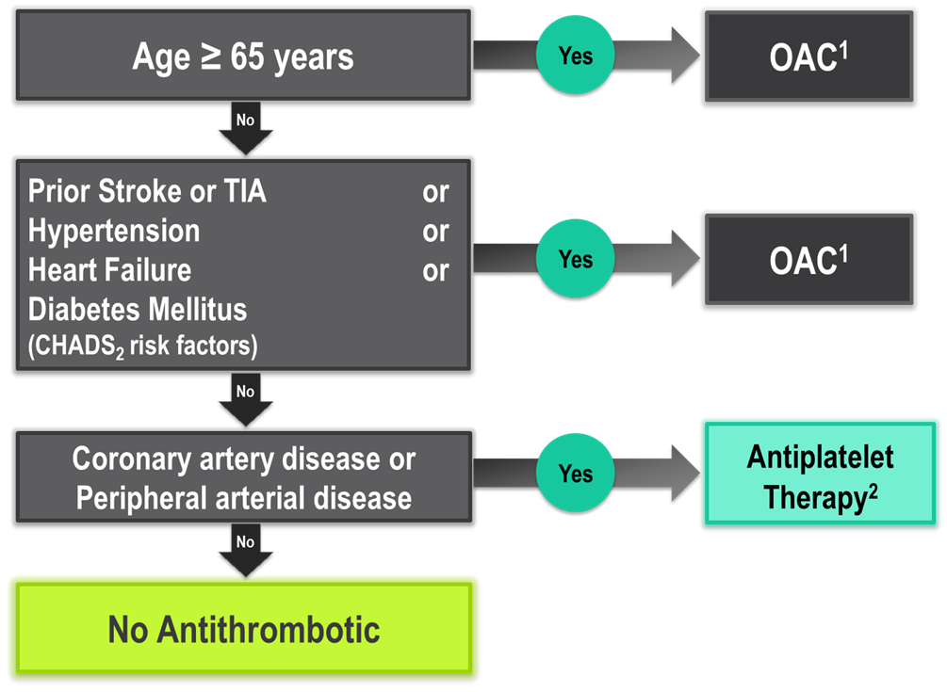
The “CCS Algorithm” (CHADS-65)
for OAC Therapy in AF
Andrade JG et al. Can J Cardiol 2018;34:1371-1392
CCS AF Guidelines. Can J Cardiol. 2016; 32: 1170-1185
¹ A DOAC is preferred over warfarin in non-valvular AF
² Therapeutic options include single antiplatelet therapy (ASA 81-100 mg daily) alone; or in combination with either a second antiplatelet agent (e.g. clopidogrel 75 mg daily or ticagrelor 60 mg BID), or an antithrombotic agent (rivaroxaban 2.5 mg BID)
Notes:
Speaker Notes:
This is the new and important slide from the 2018 (box to the right is from the 2016 update) Canadian AF guidelines update.
Two key points to emphasize: the (*) indicates that a DOAC should be selected in preference to an AVK for anticoagulation. The shaded box to the right emphasizes that all efforts should be made to select the correct DOAC dosage based on age, size and renal function as well as to minimize the bleeding risk by addressing any modifiable bleeding risk factors present.
There is no longer any need to calculate a patient’s HASBLED score as this does not influence management (most patients are antioagulated even, if at higher bleeding risk..)
Canada has not adopted the CHADSVASC scoring system to determine eligibility for oral anticoagulation in AF. The annual embolic stroke risk threshold for anticoagulation is set at 1.5% and it is felt that a vascular diseased patient who is aged 64 or less and CHADS2 = 0 has an annual stroke risk of less than 1.5% based on the Canadian Guideline Committee’s interpretation of currently available large data sets.

Slide 26
Underuse of Anticoagulants is Common in the Elderly With AF
Characteristics associated with anticoagulant underuse:
Aspirin use¹
Alcohol abuse¹
Age ≥90 years¹
Recurrent falls²
Past history of bleeding²
Paroxysmal AF²
Advanced age ²
1. Maes F, et al, Clin Interv Aging. 2014 Jul 15; 9:1091-99.
2. Bahri O, et al. J Am Geriatr Soc. 2015 Jan; 63(1):71-6.
Notes:
Speaker Notes:
These data come from two European studies among older patients with AF. One was a cross-sectional study in Belgium of 773 consecutive geriatric patients aged 75 years or older with AF and a clear anticoagulation indication (CHADS2 ≥2 upon hospital admission). Among these individuals, anticoagulation underuse was observed in 384 (50%) of 773 patients. Furthermore among those who were receiving anticoagulation, use was suboptimal. A total of 330 patients were on warfarin and 59 were on or low molecular weight heparin. Among the 330 patients on warfarin, the admission INR was infra-therapeutic in 56% and supra-therapeutic in 22%.
The other study was a cross-sectional French study of 1,085 nursing home residents with a history of AF. Among these patients once again, half were not receiving anticoagulant therapy.
In the hospital study, the authors reported that the main characteristic associated with anticoagulation underuse was aspirin use. Other independent predictors were alcohol abuse and age 90 or older. In the nursing home study, recurrent falls past history of bleeding, paroxysmal
AF and advanced age were significantly associated with not prescribing anticoagulants.
In the nursing home study, physicians were also queried as to why anticoagulants were not prescribed. Recurrent falls (47%), cognitive impairment (22.6%), and advanced age (16.4%) were the main reasons given.
References:
1. Maes F, Dalleur O, Henrard S, et al. Risk scores and geriatric profile: can they really help us in anticoagulation decision making among older patients suffering from atrial fibrillation? Clin Interv Aging 2014; 9:1091-99.
2. Bahri O, Roca F, Lechaniet T, et al. Underuse of Oral Anticoagulation for Individuals with Atrial Fibrillation in a Nursing Home Setting in France: Comparisons of Resident Characteristics and Physician Attitude. J Am Geriatr Soc 2015; 63(1):71-6.

Slide 27
Burden of Inappropriate Prescription of DOAC in the Elderly
Inappropriate prescription at admission: 30.6%
Underdosing 21%, Overdosing 6.4%, Indication 2.6%, Inappropriate schedule 0.6%
Inappropriate prescription at discharge: 22.4%
Underdosing 21.7%, Overdosing 4.6%, Indication 0.7%
Drug | Admission | Discharge
Apixaban | 27.4% | 26.6%
Dabigatran | 30% | 25%
Rivaroxaban | 36.5% | 30%
Inappropriate prescription according to specific drug
Bruneau A, et al. Drugs Aging, September 2019 [Epub ahead of print].
Notes:
Speaker Notes:

Slide 28
What’s Different about Residents of Long-Term Care?
Homes were originally resourced, built and equipped to provide assistance with activities of daily living (ADL) – bathing, dressing, eating, toileting, etc.
Since 2010 the shift to home care has dramatically changed the role of long-term care in the health care continuum.
only seniors with high or very high care needs are eligible for long-term care.
older, frailer, and in need of more care.
38% are being monitored for an acute condition
77% extensive assistance or are totally dependent
1/6 residents receives 13 or more medications
average length of stay in 2012 was 1.6 years (reducing)
Excerpted from This is Long-Term Care 2014 and This is Long-Term Care 2015 by the Ontario Long Term Care Association.
Notes:
Speaker Notes:

Slide 29
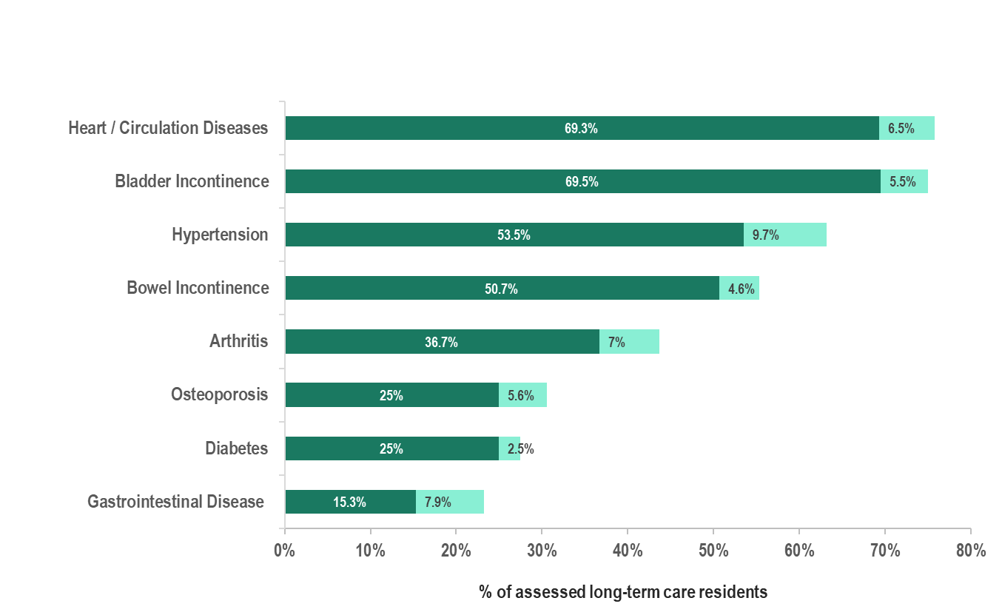
Residents of Long Term Care: Rapid Change, Dramatic Impact
Significant changes in resident profiles in the last 5 years
Later stage of life, with more complex health issues and are more physically frail
97% of new residents ≥ 2 chronic conditions like diabetes, COPD, Afib or CHF
Prevalence as of 2009-2010
Increase in prevalence between 2009-2010 and 2014-2015 (inclusive)
Number at end of each bar:
Prevalence as of 2014-2015
Canadian Institute for Health Information, Continuing Care Reporting System (CCRS 2009-2010 and CCRS 2014-2015)
JAGS 51:S265 2003, Diab Care 20:585 1997, Diab Med 1:S41, 1998
Notes:
Speaker Notes:

Slide 30
Residents of Long Term Care: Rapid Change, Dramatic Impact
Management Highly Variable!
No Guidelines from LTC
INDIVIDUALIZED APPROACH IS NECESSARY!!
62% of residents live with Alzheimer’s disease or other dementias
1/3 have severe cognitive impairment.
46% of residents exhibit some level of aggressive behavior.
40% of residents have a psychiatric diagnosis (anxiety, depression, bipolar disorder or schizophrenia)
Dual diagnosis (e.g., dementia coupled with a psychiatric diagnosis) is increasing at 11% per year.
97% of residents have 2 or more chronic diseases.
Excerpted from This is Long-Term Care 2014 and This is Long-Term Care 2015 by the Ontario Long Term Care Association.
Notes:
Speaker Notes:

Slide 31
Atrial Fibrillation in Long Term Care
Atrial Fibrillation in LTC reaches a prevalence of 17-25% ^{1,3}
1990’s “warfarin era” only 32% of patients with Afib in LTC were on OAC²
2015 Study of 25 LTC homes in Ontario^{3,4}
37% of eligible elderly LTC residents failed to receive recommended stroke prevention therapies
(26% warfarin, 37% DOAC)
Secondary Stroke Prevention was lower with:
Advanced age, dementia, and long-term care residence ⁵
1. Rich, Michael W.Journal of the American Medical Directors Association , Volume 13 , Issue 8 , 688 – 691
2. Arch Intern Med. 1997;157(9):978-984. JAMDA 2012; 13(8):688-691
3. O'Donnell, DenisNavare, Hrishikesh et al.Journal of the American Medical Directors Association , Volume 18 , Issue 3 , B17
4. Shurrab, Mohammed et. al. J Interv Card Electrophysiol (2017) 48: 261.
5. Shah, Reema et. al.Medical Care: October 2016 - Volume 54 - Issue 10 - p 907–912
Notes:
Speaker Notes:

Slide 32
Reflecting on Atrial Fibrillation Living in Long Term Care
This elderly, frail and high-risk group of patients has a high prevalence of AF and a high risk of morbidity from strokes
Varied spectrum of patients live in LTC, from functionally independent to fully dependent
These patients are often under treated with anticoagulation
Individualisation of treatment is required
No formal screening programs are in place in most LTC homes, this is worthy of consideration and identification and treatment of these patients is a valuable Quality Improvement Project
1. Stolker JM, et al. Circulation 2014; 130(15):1254-61.
Notes:
Speaker Notes:

Slide 33
Case 6
Beth has decided she wants to take meds to prevent stroke.

Slide 34
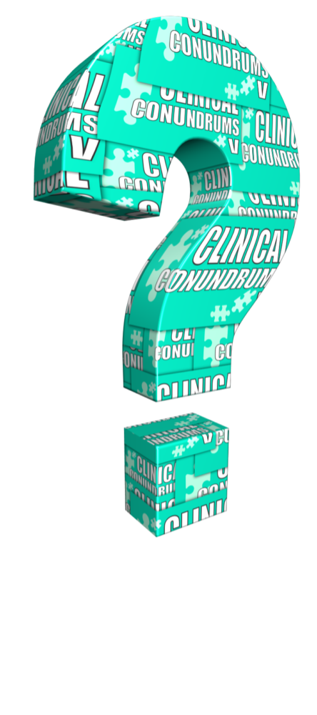
What would be your choice for Beth?
Select from one or more of the available options
Warfarin to INR 2-3
Apixaban 5mg bid
Apixaban 2.5 mg bid
Dabigitran 150 mg bid
Dabigatran 110 mg bid
Edoxaban 60 mg od
Edoxaban 30 mg od
Rivaroxaban 20 mg od
Rivaroxaban 15 mg od
Notes:
Speaker Notes:
Response options provided on slide 40

Slide 35
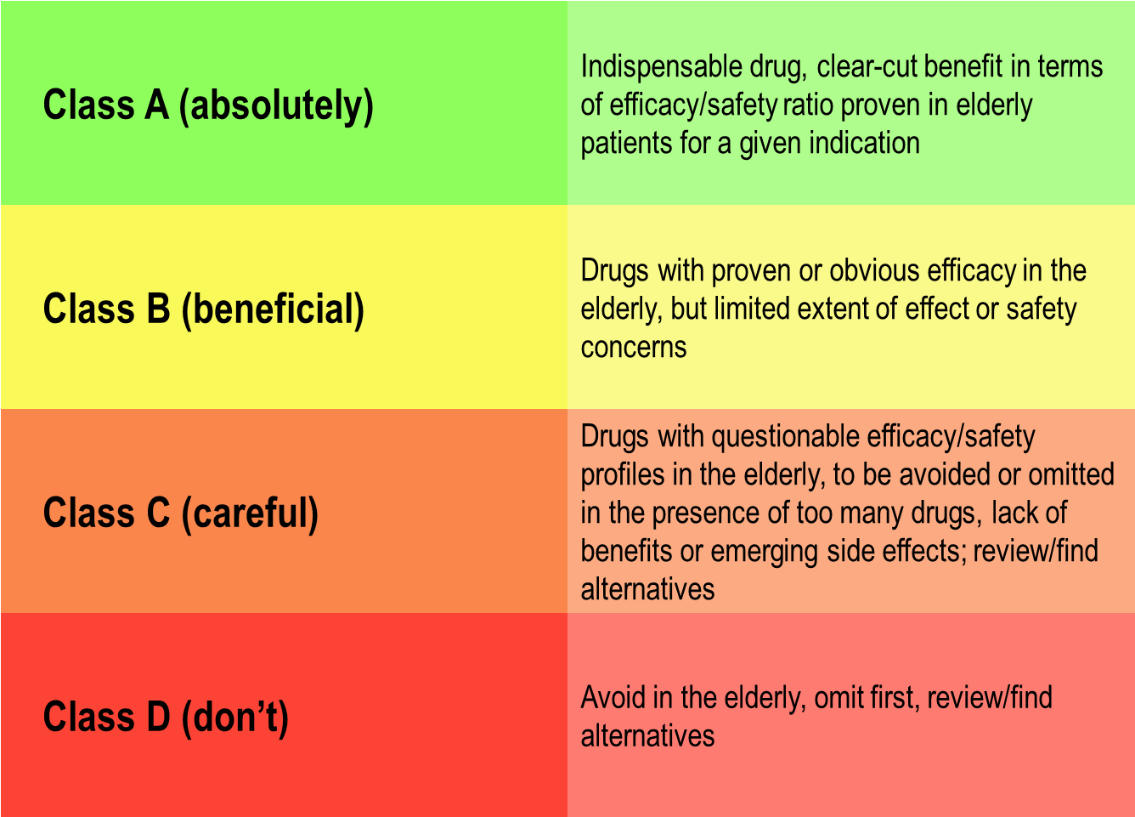
The FORTA (Fit for the Aged) List
Wehling M, Collins R, Gil VM, et al. Appropriateness of oral anticoagulants for the long-term treatment of atrial fibrillation in older people: results of an evidence-based review and international consensus validation process (OAC-FORTA 2016). Drugs Aging 2017; 34, 499-507
Notes:
Speaker Notes:
Classifies medications frequently prescribed to older patients
Structured literature search identified evidence for experts
Delphi process – individual ranking by experts into Class A, B, C, D
Considers age-dependent tolerance, compliance, polypharmacy, multi-morbidity, frequency of relative contraindications
Updated list at http://www.umm.uni-heidelberg.de/ag/forta/
Utility demonstrated in prospective randomized trials
A list of the fitness of various drugs with respect to their use in the elderly maintained by the University of Heidelberg. The Delphi process refers to a process where 20 experts in the field are provided a summary of a systematic review of the literature regarding a particular drug and a particular indication and are then asked to vote in secret without discussion with the others whether use of that drug for that indication in the elderly should be given a Class A, B, C, or D recommendation. After conversion of each vote into a numeral (1,2,3,4) the mean of all votes determines the final recommendation.

Slide 36
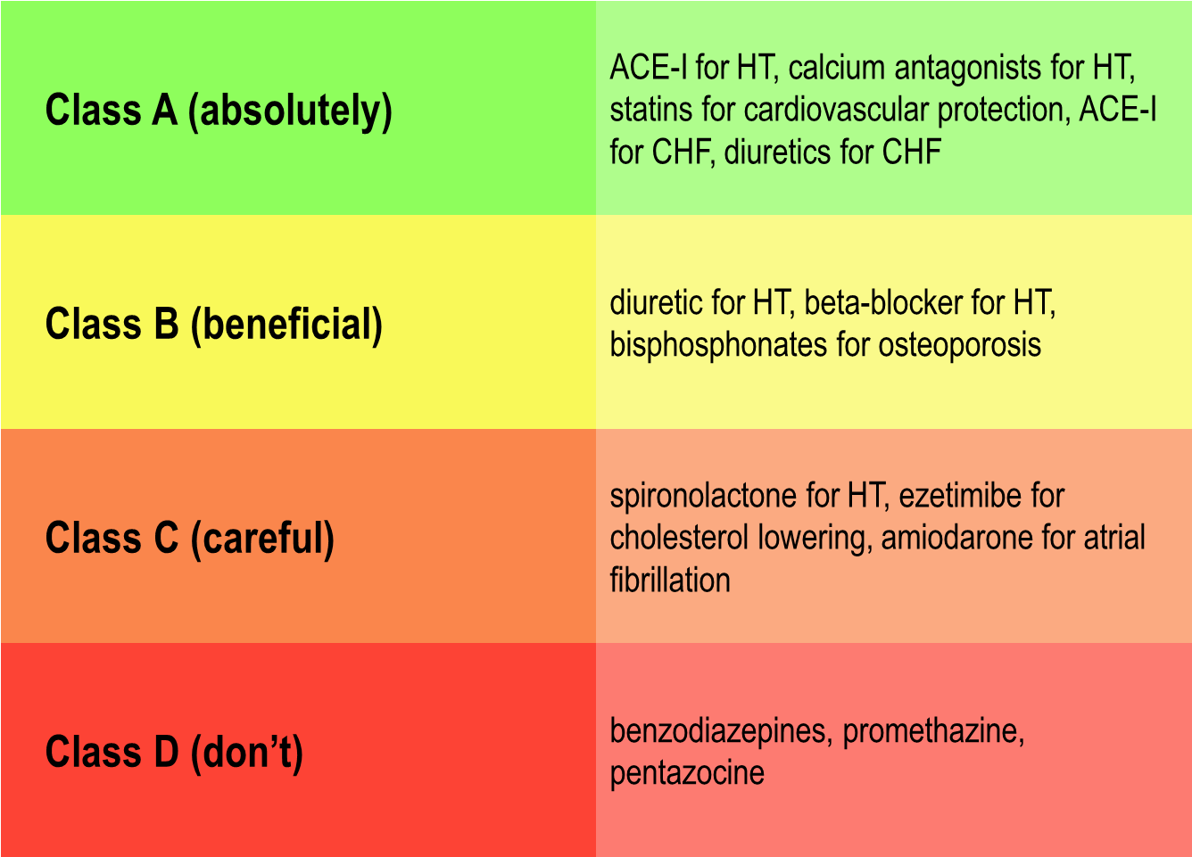
The FORTA (Fit for the Aged) List
Wehling M, Collins R, Gil VM, et al. Appropriateness of oral anticoagulants for the long-term treatment of atrial fibrillation in older people: results of an evidence-based review and international consensus validation process (OAC-FORTA 2016). Drugs Aging 2017; 34, 499-507
Notes:
Speaker Notes:
Some examples of the outcome of FORTA analysis certain drugs

Slide 37
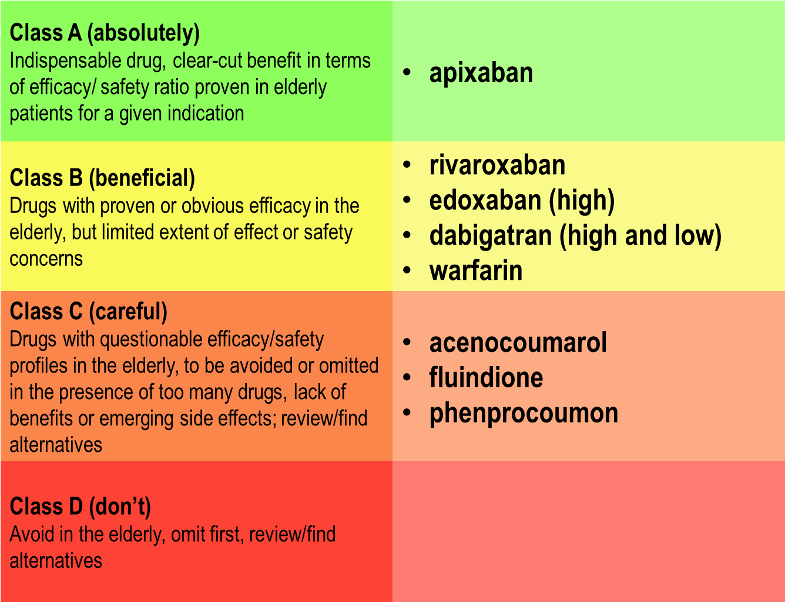
The FORTA (Fit for the Aged) List Anticoagulants for Atrial Fibrillation
Wehling M, Collins R, Gil VM, et al. Appropriateness of oral anticoagulants for the long-term treatment of atrial fibrillation in older people: results of an evidence-based review and international consensus validation process (OAC-FORTA 2016). Drugs Aging 2017; 34, 499-507
Notes:
Speaker Notes:
The outcome of the FORTA process for oral anticoagulants for stroke prevention in patients with non-valvular atrial fibrillation. High and low refer to the randomized drug doses studied. Those in the class C category are all coumadin lookalikes.

Slide 38
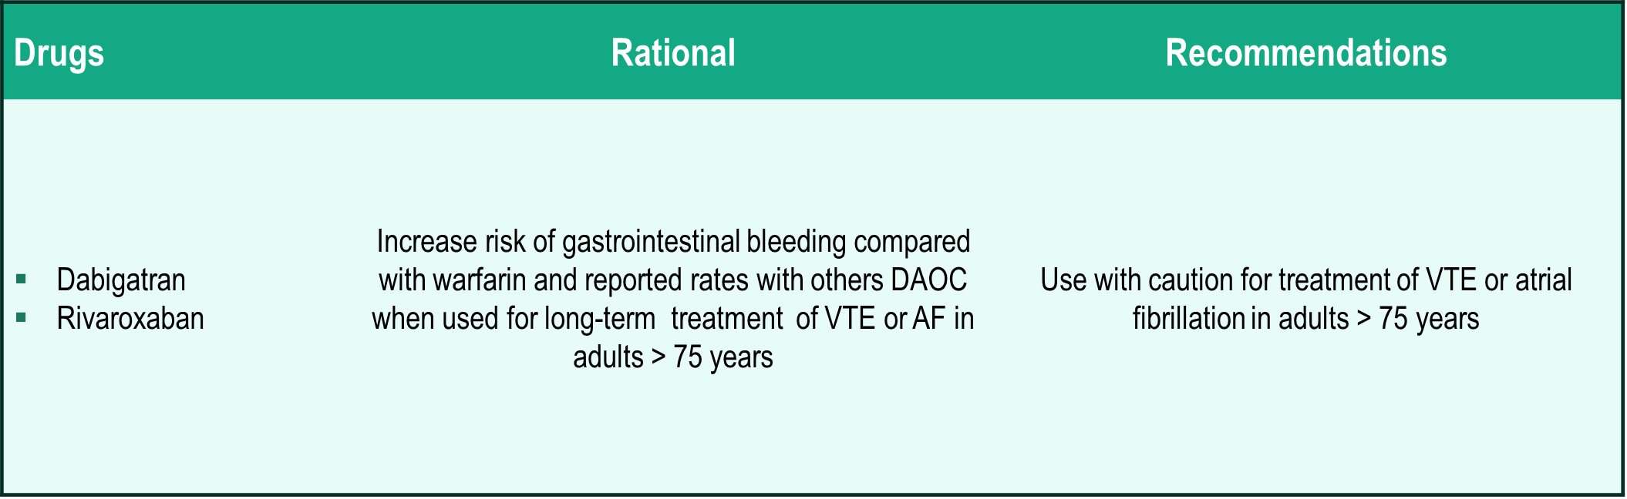
2019 AGS* Beers Criteria for Potentially Inappropriate Medications: Drugs to be Used with Caution in Older Adults
Quality of Evidence: Moderate; Strength of Recommendation: Strong
*AGS: American Geriatrics Society
2019 The American Geriatrics Society
Notes:
Speaker Notes:

Slide 39
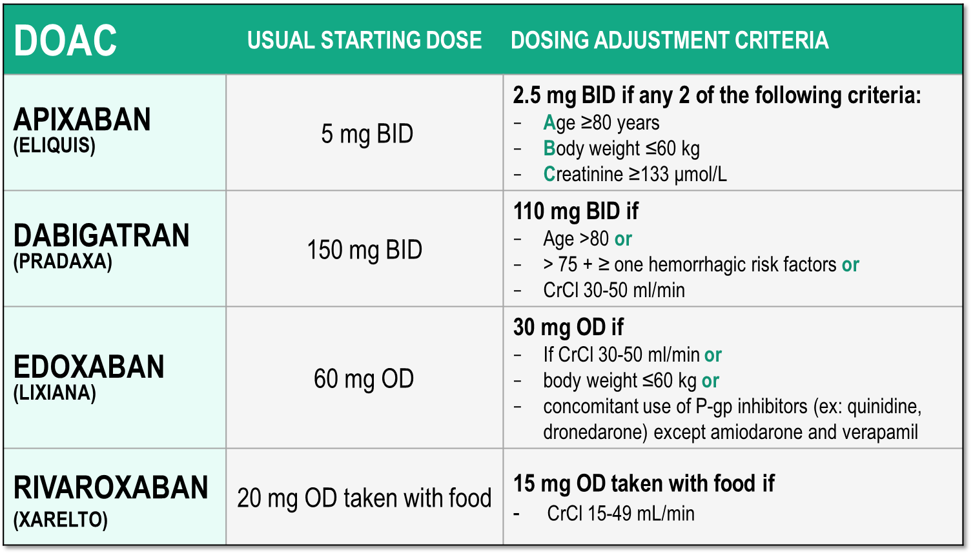
Considerations for Dosing of DOACs
Pfizer Canada Inc./BMS Canada. Eliquis (apixaban) Product Monograph, 2018.
Boehringer Ingelheim Canada Ltd. Pradaxa (dagbatran) Product Monograph. August 11, 2016.
Bayer Inc. Xarelto (rivaroxaban) Product Monograph. 2018.
Daiichi Sankyp Inc. Lixiana (edoxaban) Product Monograph. 2017.
Notes:
Speaker Notes:
Indispensable slide summarizing the criteria for a dosage adjustment from the default higher dosage for the different DOACs currently available in Canada
The dosing adjustments proposed for apixaban, edoxaban and rivaroxaban are those utilized to the dosage of selected patients enrolled in the respective prospective clinical trials (ARISTOTLE, ENGAGE and ROCKET-AF). The overall goal was to achieve a stable plasma concentration in subjects assigned to DOAC therapy in these studies.
The speaker should emphasize that the RELY study, in fact, tested two separate dosages of dabigatran (150 mg and 110 mg BID) independently against warfarin, without a pre-specified dosage reduction algorithm for reduced renal function. Since dabigatran is known to be 85% renally cleared, the Canadian AF Guidelines Committee subsequently proposed dosing adjustments (as did all other guideline committees), as listed in the table, for elderly patients and those with stage 3 renal dysfunction in order to minimize the risk of drug accumulation and bleeding in these patients.

Slide 40
What would be your choice for Beth?
Select from one or more of the available options
Warfarin to INR 2-3
Apixaban 5mg bid
Apixaban 2.5 mg bid
Dabigitran 150 mg bid
Dabigatran 110 mg bid
Edoxaban 60 mg od
Edoxaban 30 mg od
Rivaroxaban 20 mg od
Rivaroxaban 15 mg od
Why not the lower apixaban dose?
Notes:
Speaker Notes:
Response options 2, 5, 7 & 9 acceptable with respect to DOAC dose
Animation: Discussion point – why not the lower apixaban dose?

Slide 41
Case 6
Beth is worried about using these meds
at her age

Slide 42
What would you tell Beth?
Select from one of the available options
Tell her you’ll put her on ASA
Tell her Warfarin may be a better choice due to her age, and can monitor blood levels
Stroke risk LOW, so no meds actually really needed
DOAC outcomes in the elderly consistent with clinical trials
Notes:
Speaker Notes:
Response options provided on slide 45

Slide 43
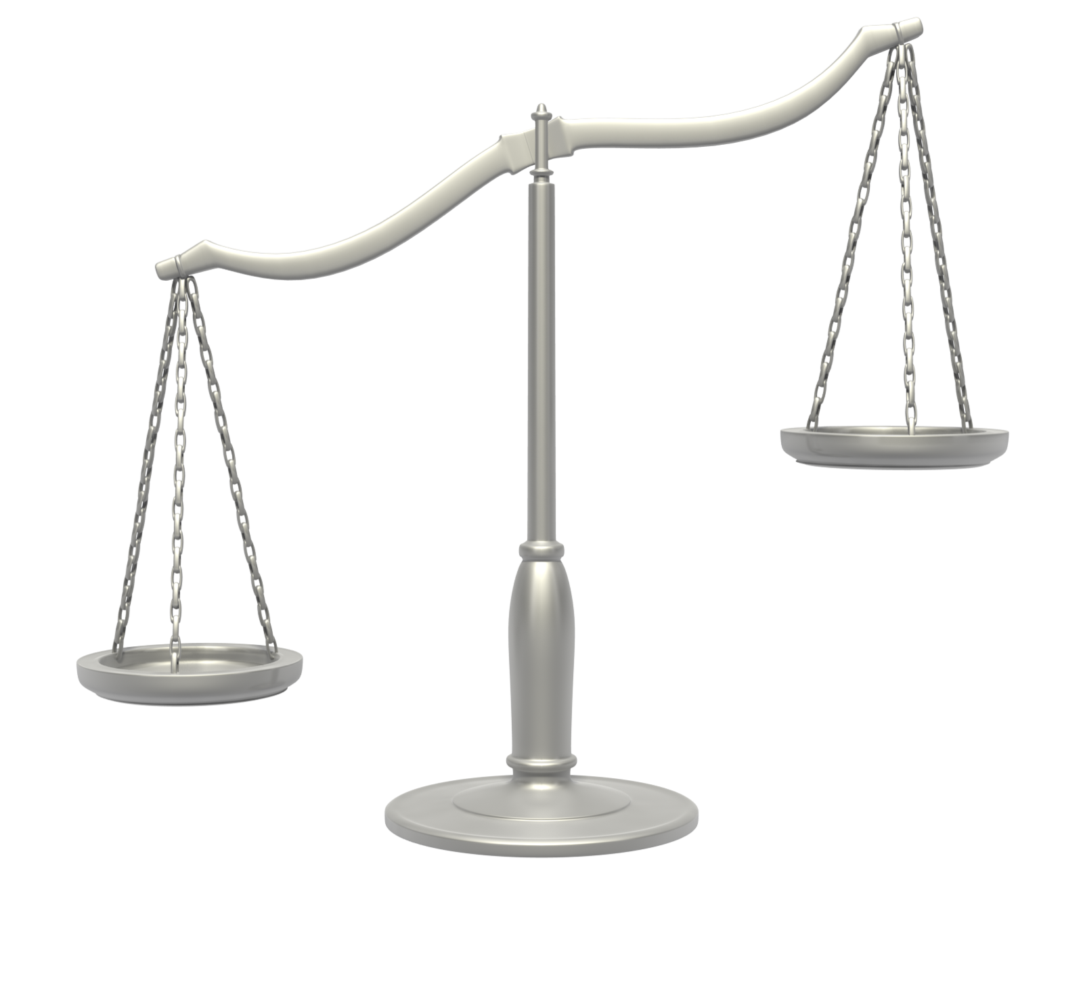
Aging and Risk
For most elderly patients, the benefits of anticoagulation outweigh the risks
Age
Atrial fibrillation
Stroke
Dementia
Falls
Bleeding
Notes:
Speaker Notes:

Slide 44
DOACs vs. Warfarin in Patients with Atrial Fibrillation (AF) : Impact on Bleeding Risk by Age
Trial, agent and dose |  | Age | Event rate, %/year |  | Hazard ratio (95% CI)
 |  |  | DOAC | Warfarin
ARISTOTLE | Apixaban 5 mg bid | < 65 65 to < 75 ≥ 75 | 1.2 2.0 3.3 | 1.5 2.8 5.2 | 0.78 (0.55-1.11) 0.71 (0.56-0.89) 0.64 (0.52-0.79)
RE-LY | Dabigatran 110 mg bid Dabigatran 150 mg bid | < 75 ≥ 75 < 75 ≥ 75 | 1.89 4.43 2.12 5.10 | 3.04 4.37 3.04 4.37 | 0.62 (0.50-0.77) 1.01 (0.83-1.23) 0.70 (0.57-0.86) 1.18 (0.98-1.42)
ROCKET AF | Rivaroxaban 20 mg qd | < 65 65 to < 75 ≥ 75 | 2.21 3.03 4.86 | 2.16 3.24 4.40 | 1.02 (0.71-1.46) 0.94 (0.73-1.21) 1.11 (0.92-1.34)
ENGAGE AF-TIMI | Edoxaban 60 mg qd | < 75 ≥ 75 | 2.02 4.01 | 2.62 4.83 | 0.83 (0.70-0.99)
Diener HC, et al. Eur Heart J. 2016 Feb 4.
Notes:
Speaker Notes:
All of the AF trials confirmed the increased risk of major bleeding among older adults compared with younger individuals. Among the DOACs, only apixaban and edoxaban retained superiority over warfarin for bleeding among the oldest subgroup.
References:
1. Connolly SJ, Ezekowitz MD, Yusuf S, et al. Dabigatran versus warfarin in patients with AF. N Engl J Med 2009; 361:1139-51.
2. Patel MR, Mahaffey KW, Garg J, et al. Rivaroxaban versus warfarin in nonvalvular AF. N Engl J Med 2011; 365:883-91.
3. Granger CB, Alexander JH, McMurray JJ, Lopes RD, Hylek EM, Hanna M, et al. Apixaban versus warfarin in patients with AF. N Engl J Med. 2011;365:981–992.
4. Connolly SJ, Eikelboom J, Joyner C, Diener H-C, Hart R, Golitsyn S, et al. Apixaban in patients with AF. N Engl J Med. 2011; 364:806-17.
Cited in: Diener HC, Aisenberg J, Ansell J, et al. Choosing a particular oral anticoagulant and dose for stroke prevention in individual patients with non-valvular atrial fibrillation: part 2. Eur Heart J. 2016 Feb 4. [Epub ahead of print].

Slide 45
What would you tell Beth?
Select from one of the available options
Tell her you’ll put her on ASA
Tell her Warfarin may be a better choice due to her age, and can monitor blood levels
Stroke risk LOW, so no meds actually really needed
DOAC outcomes in the elderly consistent with clinical trials
Notes:
Speaker Notes:
Correct response: 4

Slide 46
Case 6
Beth has heard there is no antidote and she is worried about bleeding on apixaban.

Slide 47
What would you tell Beth?
Select from one or more of the available options
Switch her to warfarin to have availability of Vit K
Stop all meds as she is right
Explain that an antidote is coming for the Xa inhibitors
Switch her to dabigatran 110 mg bid which has an antidote now (idarucizumab)
Explain to her that in fact her risk of dying from a bleed is much less on DOACs than on warfarin
Notes:
Speaker Notes:
Response options provided on slide 49

Slide 48
Major bleeds on DOAC are 34% less likely to lead to death than bleeds occurring with VKAs
 | DOAC |  |  | VKA |  |  | Odds Ratio | Odds Ratio
Study or Subgroup | Events |  | Total | Events | Total | Weight | M-H, Random, 95% CI | M-H, Random, 95% CI
AF Population
ARISTOTLE |  | 34 | 327 | 55 | 462 | 22,9% | 0.86 (0.33, 1.35)
ENGAGE AF-TIMI 48 |  | 53 | 672 | 59 | 524 | 31,0% | 0.67 (0.46, 1.00)
J-ROCKET AF |  | 1 | 23 | 3 | 27 | 0,9% | 0.36 (0.04, 3.76)
RE-LY |  | 28 | 399 | 39 | 421 | 18.4% | 0.74 (0.45, 1.23)
ROCKET AF |  | 27 | 395 | 55 | 386 | 20.1% | 0.44 (0.27, 0.72)
Subtotal (95%) |  |  | 1816 |  | 1820 | 93.2% | 0.66 (0.52, 0.84)
Total events |  | 143 |  | 211
Heterogeneity: Tau² = 0,01; Chi² = 4,40, df= 4 (P= 0,35); 1² = 9%
Test for overall effect: Z = 3,39 (P = 0,0007)
AF: Atrial Fibrillation
Hylek EM, et al. J Am Coll Cardiol 2014; 63(20):2141-7. Piccini JP, et al. Eur Heart J 2014; 35(28):1873-80.
Giuliano RP et al NEJM 2013; 369:2091 Majeed A, et al. Circulation 2013; 128(21):2325-32.
.
PLoS One, 2015; 10(9):e0137444 Published online 2015 Setp 18. doi: 10.137/journal.pone.0137444
Notes:
Speaker Notes:
RESEARCH ARTICLE
Risk of Fatal Bleeding in Episodes of Major Bleeding with New Oral Anticoagulants and Vitamin K Antigonists: A Systematic Review and Meta-Analysis
Joel Skaistis*, Travis Tagami: Department of Internal Medicine, William Beaumont Hospital, Royal Oak, Michigan, United States of America

Slide 49
What would you tell Beth?
Select from one or more of the available options
Switch her to warfarin to have availability of Vit K
Stop all meds as she is right
Explain that an antidote is coming for the Xa inhibitors
Switch her to dabigatran 110 mg bid which has an antidote now (idarucizumab)
Explain to her that in fact her risk of dying from a bleed is much less on DOACs than on warfarin
Notes:
Speaker Notes:
Response Options: 4 & 5 in fact . Fatal bleeding <<<<<<DOAC then Warfarin Antidote rarely needed and Factor X antidote could be a few years away Vit K is NOT an antidote for Warfarin

Slide 50
Case 6
Beth wonders when she should see you for her next follow-up appointment.

Slide 51
For when do you schedule Beth’s
next appointment?
Select from one of the available options
1 month to recheck renal function
4-6 months for diabetes and renal function check
All good, see you in one year
Notes:
Speaker Notes:
Response options provided on slide 53

Slide 52

CCS AF Guidelines for Follow-up
RECOMMENDATION
Patients with AF who are receiving OAC have their renal function assessed at least annually by measuring serum creatinine and calculating eGFR
(Strong Recommendation, Moderate-Quality Evidence).
PRACTICAL TIP
Patients with eGFR 30-50 mL per minute need more frequent measures of eGFR…especially with age over 75 years
Skanes AC et al. Can J Cardiol 28:125, 36, 2012.
Notes:
Speaker Notes:

Slide 53
For when do you schedule Beth’s
next appointment?
Select from one of the available options
1 month to recheck renal function
4-6 months for diabetes and renal function check
All good, see you in one year
Notes:
Speaker Notes:
Correct Response: 2

Slide 54

Key Messages
AF-related stroke risk rises in the elderly
DOACs are as effective in older patients as they are in younger patients with AF, with a major bleeding risk that is less than or similar to that of warfarin
Doses of DOACs may need to be adjusted in some older patients. e.g., depending on renal function, age, and/or weight
Assess renal function and monitor closely elderly patients who receive the DOACs as they are more dependent on renal excretion
Informed decisions related to stroke prevention in elderly/frail patients must take into account patient values and preferences
Notes:
Speaker Notes:

Slide 55
Backup Slides

Slide 56
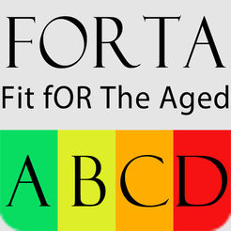
The FORTA (Fit for the Aged) List
Classifies medications frequently prescribed to older patients
Structured literature search identified evidence for experts
Delphi process – individual ranking by experts into Class A, B, C, D
Considers age-dependent tolerance, compliance, polypharmacy, multi-morbidity, frequency of relative contraindications
Updated list at http://www.umm.uni-heidelberg.de/ag/forta/
Utility demonstrated in prospective randomized trials
Wehling M, Collins R, Gil VM, et al. Appropriateness of oral anticoagulants for the long-term treatment of atrial fibrillation in older people: results of an evidence-based review and international consensus validation process (OAC-FORTA 2016). Drugs Aging 2017; 34, 499-507
Notes:
Speaker Notes:

Slide 57

DOAC Monitoring Checklist And Quick Reference Tables
Notes:
Speaker Notes:

Slide 58
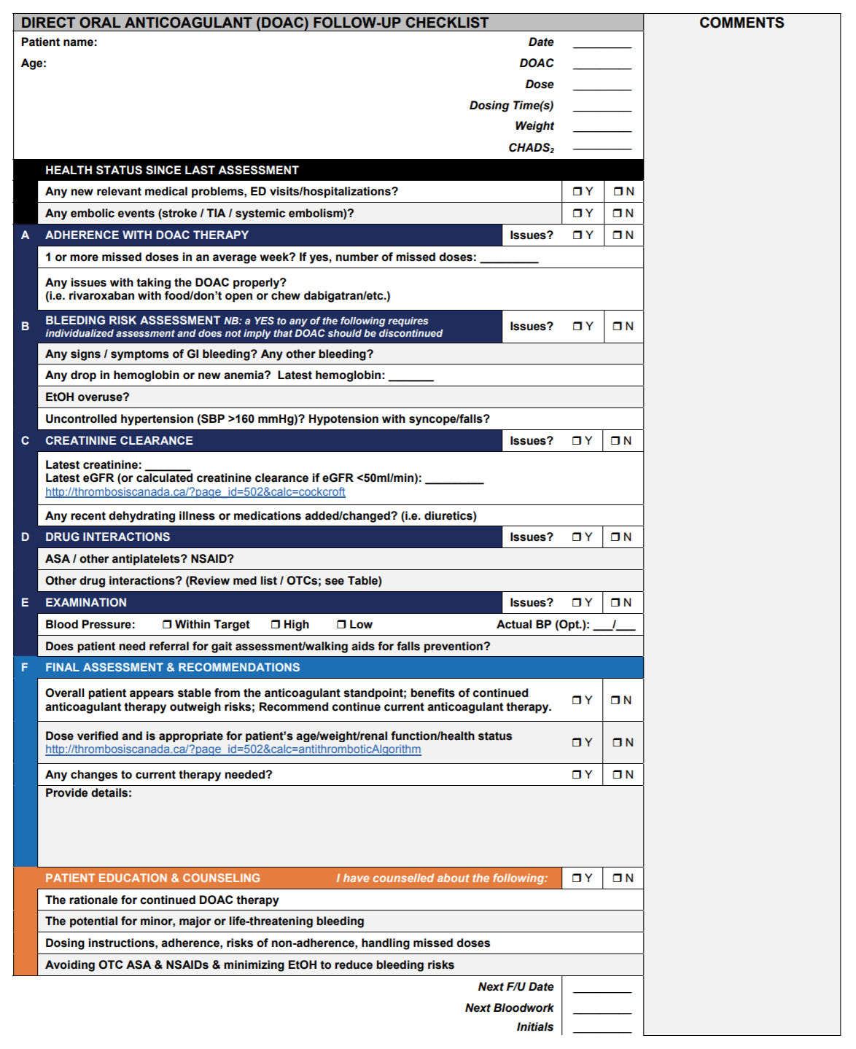
Notes:
Speaker Notes:

Slide 59
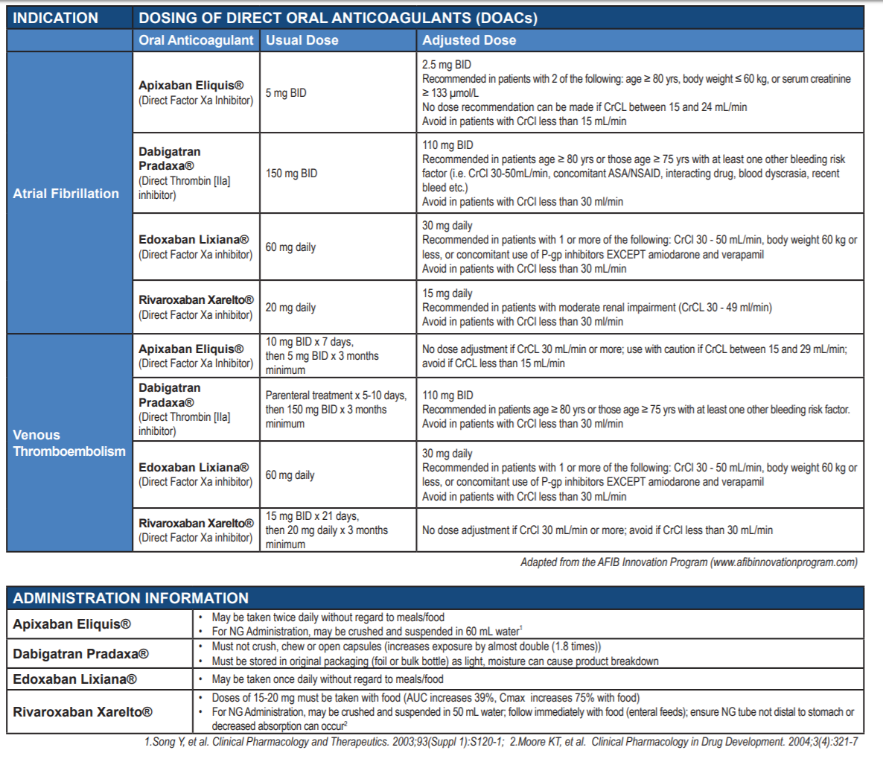
Notes:
Speaker Notes:

Slide 60
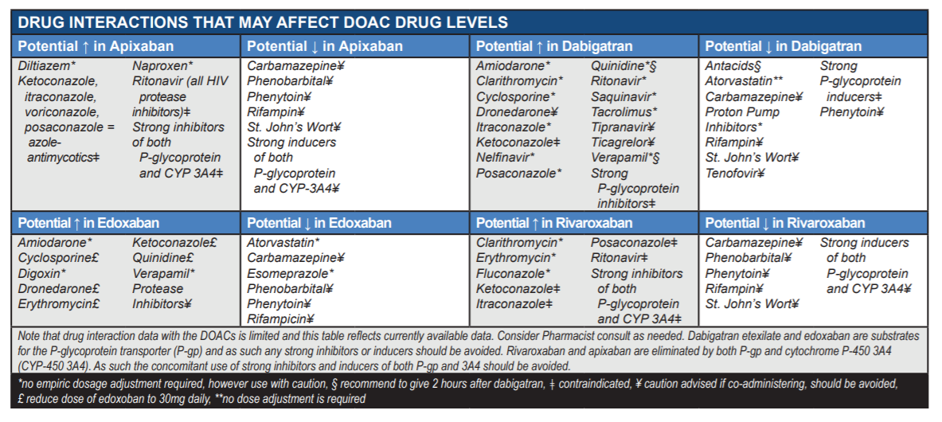
Notes:
Speaker Notes:

Slide 61
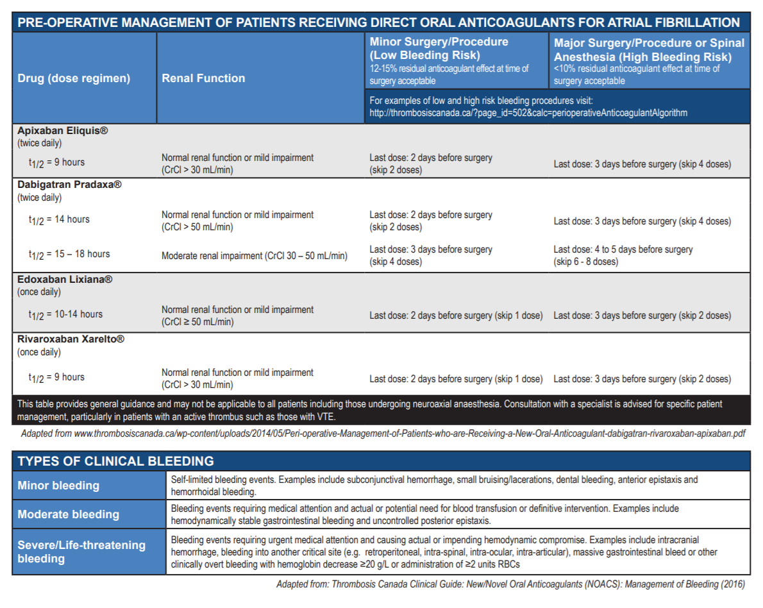
Notes:
Speaker Notes:

Slide 62
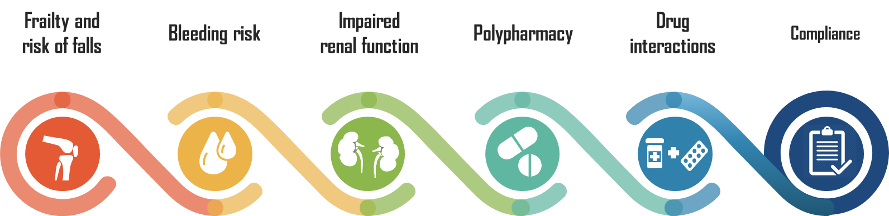
Considerations for Elderly Patients
Notes:
Speaker Notes:
The management of elderly patients is more complicated due to the higher prevalence of comorbid conditions and health-related concerns that increase in prevalence with age.
The management of elderly patients should take into consideration:
Frailty and risk of falls
Bleeding risk
Impaired renal function
Polypharmacy
Drug interactions
Compliance

Slide 63
Considerations The Effect of Bleeding Risk and Frailty Status on Anticoagulation Patterns in Octogenarians with Atrial Fibrillation: The FRAIL-AF Study Elderly Patients
p < 0.0001
CHADS₂ score
HAS-BLED score
CFS score
p < 0.0001
p < 0.0006
Lefebvre MC, et al. Can J Cardiol. 2016 Feb; 32(2):169-76.
Notes:
Speaker Notes:
These data come from a cross-sectional study was conducted in 682 hospitalized patients aged 80 years and older with AF or atrial flutter in Montreal. Consumption of warfarin or a new oral anticoagulant was documented. Medical record data were used to determine each patient’s frailty status using the Clinical Frailty Scale (CFS) and to evaluate the risk of stroke (CHADS2) and bleeding (HAS-BLED).
As shown in the figure, octogenarians with a higher risk of thromboembolism, a lower risk of bleeding, and a lower frailty score had a higher
probability of receiving anticoagulation therapy. Notably, these relationships remained significant in multivariable logistic regression analyses controlled for age, history of falls, length of hospital stay, use of antiplatelet agents, and the CHADS2, HAS-BLED, and CFS scores.
Reference:
Lefebvre MC, St-Onge M, Glazer-Cavanagh M, et al. The Effect of Bleeding Risk and Frailty Status on Anticoagulation Patterns in Octogenarians With Atrial Fibrillation: The FRAIL-AF Study. Can J Cardiol 2016; 32(2):169-76.

Slide 64
Risk of Falls and Major Bleeding
Unadjusted time to first major bleed according to risk of falling¹
1.0
0.8
p=0.65 (log-rank test)
Risk of Major Bleed¹
HR: 1.09 (0.54-2.21)
(high vs. low risk of falls)
0.6
Proportion Event-free
0.4
0.2
High Risk of Falls
Low Risk of Falls
0.0
0
100
200
300
400
Time to First Bleeding Event (days)
For the calculated risk of subdural hematoma from falling to outweigh the stroke reduction benefit of warfarin, a patient with a 5% annual stroke risk from AF would need to fall 295 times in 1 year²
Donzé et al. Am J Med. 2012;125:773-8; 2. Man-Son-Hing et al. Arch Intern Med. 1999;159:677-85.
Man-Son-Hing M, Nichol G, Lau A, et al. Choosing antithrombotic therapy for elderly patients with atrial fibrillation who are at risk for falls. Arch Intern Med. 1999;159:677-85.
Notes:
Speaker Notes:
The risk of falling is the most commonly cited reason for not providing oral anticoagulation, however risk calculations show this is not an adequate reason to avoid oral anticoagulation.
Five hundred and fifteen adult medical patients discharged on an oral anticoagulant were prospectively studied for the outcome of time to first major bleed within a 12-month follow-up period (adjusted for age, sex, alcohol abuse, number of drugs, concomitant treatment with antiplatelet agents and history of stroke or transient ischemic attack). Overall, 308 patients (59.8%) were at high risk of falling, and these patients had a nonsignificant higher crude incidence rate of major bleeding than patients at low risk of falling (8.0 vs 6.8 per 100 patient-years, p=0.64). In a multivariate analysis, a high falling risk was not associated with a statistically significant risk of a major bleed (hazard ratio 1.09; 95% confidence interval, 0.54-2.21). Overall, only 3 major bleeds occurred directly after a fall (incidence rate: 0.6 per 100 patient-years).
To assess whether the risk of falling should influence the choice of antithrombotic therapy in elderly patients with AF, a Markov decision model was used to determine the preferred treatment strategy for patients with AF who are 65 years of age and older, at risk of falling, and had no other contraindications to antithrombotic therapy. The authors found that for the calculated risk of subdural hematoma from falling to outweigh the stroke reduction benefit of warfarin, a patient with a 5% annual stroke risk from AF would have to fall 295 times in 1 year.²
References:
Donzé J, Clair C, Hug B, et al. Risk of falls and major bleeds in patients on oral anticoagulation therapy. Am J Med. 2012;125:773-8.
Man-Son-Hing M, Nichol G, Lau A, et al. Choosing antithrombotic therapy for elderly patients with atrial fibrillation who are at risk for falls. Arch Intern Med. 1999;159:677-85.

Slide 65
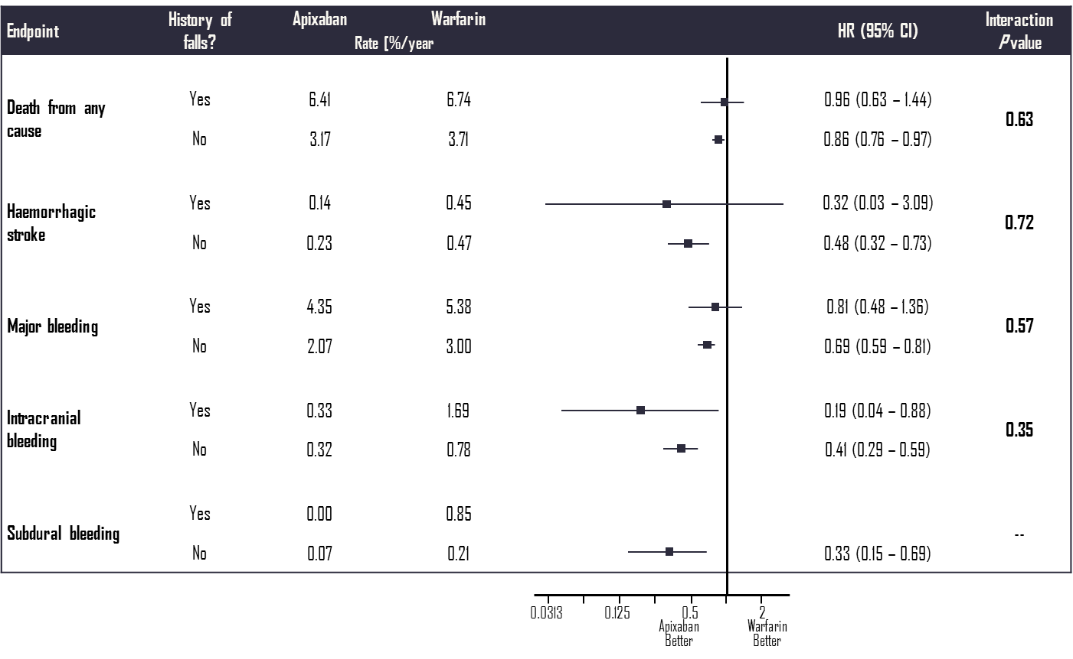
Patients with Atrial Fibrillation and History of Falls Are at High Risk for Bleeding and Have Less Bleeding with Apixaban Than Warfarin: Results from the ARISTOTLE Trial
CI, confidence interval;
HR, hazard ratio.
Rao P, et al. Presented at ESC 2016. abstract #1352.
Notes:
Speaker Notes:
This subanalysis was conducted to enhance understanding of whether a history of falls impacts on the relative benefits of apixaban vs. warfarin as observed in the ARISTOTLE trial.
The analysis included the 16,491 patients in ARISTOTLE with information available about history of falls. Of these, 753 (4.6%) patients had a history of falls in the past year prior to baseline.
Compared with those without history of falls, patients with a falls were older (median 75 vs. 70 years), more likely to be female, to have dementia, depression, osteoporosis, fractures, prior bleeding of most types, higher CHADS2 (mean 2.53 vs. 2.14) and HASBLED scores (mean 2.40 vs. 1.77), and higher rates of study drug discontinuation.
In terms of efficacy, those with or without falls had similar adjusted rates of stroke and of hemorrhagic stroke as those without a history of falls; however, as shown in the figure, they had higher rates of major bleeding (HR 1.39, 95% CI 1.05-1.85) and mortality (HR 1.70, 95% CI 1.36-2.14).
The benefits of apixaban, compared with warfarin, on stroke/SE, bleeding, MI, and death were preserved,
irrespective of falls.
Reference:
Rao P, Alexander JH, Wojdyla D, et al. Patients with atrial fibrillation and history of falls are at high risk for bleeding but have less bleeding
with apixaban than warfarin: results from the ARISTOTLE trial. Presented at ESC 2016. abstract #1352.

